Slide 1
A Computational Workflow to Determine Saddle Position Effects on Metabolic Energy Expenditure Rate While Cycling
18 March 2021
Chelsea Chen, Cait Clancy, David Gonzalez, Sepehr Rostamzadeh
ME 329
Notes:
SR - 5 min

Slide 2
Introduction
Notes:
SR
To recap quickly our prob def. & context...

Slide 3
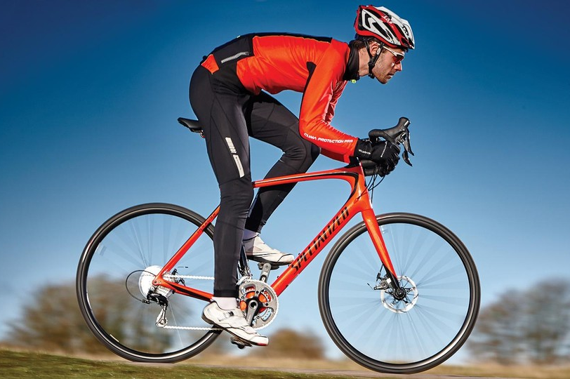
(from Specialized)
How do we make the most efficient mode of transportation even more efficient?
Notes:
SR

Slide 4
Cycling Efficiency is...
Notes:
SR
We are trying to determine how seat position, defined by the x and y distance in meters from the bottom bracket of the bike, affects metabolic energy expenditure rate. We know from literature that an optimal saddle position is achieved when metabolic energy expenditure rate is minimized. Where metabolic energy expenditure rate is defined as the energy expenditure of the system proportional to the sum of the resting metabolic expenditure rate and the ATP consumption rate of each muscle.
Determining this relationship, specifically determining the optimal saddle positions in which the energy expenditure is minimized, is an area of interest for the cycling company, Specialized, who work with elite cyclists

Slide 5
Cycling Efficiency is...
The ratio of power output at the wheels to the metabolic energy expenditure rate of the rider
Notes:
SR
We are trying to determine how seat position, defined by the x and y distance in meters from the bottom bracket of the bike, affects metabolic energy expenditure rate. We know from literature that an optimal saddle position is achieved when metabolic energy expenditure rate is minimized. Where metabolic energy expenditure rate is defined as the energy expenditure of the system proportional to the sum of the resting metabolic expenditure rate and the ATP consumption rate of each muscle.
Determining this relationship, specifically determining the optimal saddle positions in which the energy expenditure is minimized, is an area of interest for the cycling company, Specialized, who work with elite cyclists

Slide 6
Metabolic Energy Expenditure Rate (MEER)
Experimentally measured via indirect calorimetry
ATP consumption in muscle fibers
Rate at which heat is released and muscles perform work
Notes:
SR
Conversion of chemical to mechanical power produced by muscles

Slide 7
Factors Affecting MEER During Cycling
Kinematics
Muscle Activation
Cycling MEER
Pedaling Cadence
Cycling Shoe Placement
Notes:
SR

Slide 8
Related Works & Background
Notes:
SR
To recap quickly our prob def. & context...

Slide 9
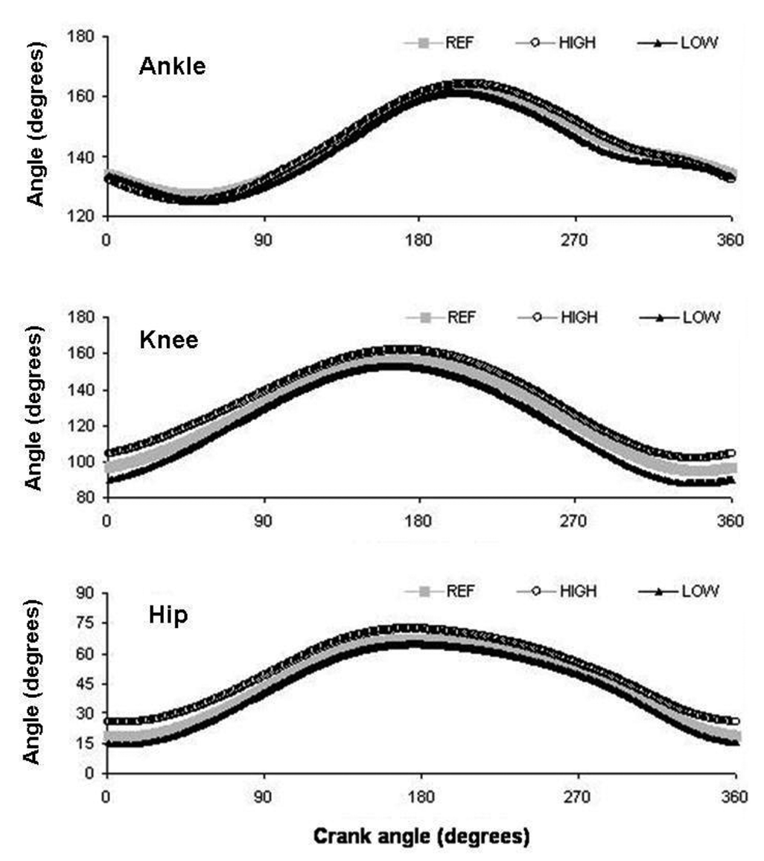
Review: Cycling Research
Extensive cycling research exists on cycling kinematics, dynamics, and MEER (Faulkner 2020, Leib 2008, Dembia 2017, Coleman 2007, Hull 1985, Gonzalez 1989, Fonda 2010)
Studies often use electromyography (EMG) and motion capture data to acquire muscle activation and joint angle data
Joint angles for ankle, knee, hip as a function of crank angle (Bini 2010)
Notes:
SR
As a review, many cycling experiments have been done looking at cycling kinematics, dynamics, and power generation.
Experimental data, such as electromyography for muscle activation, and motion capture was collected to validate computational modeling.

Slide 10
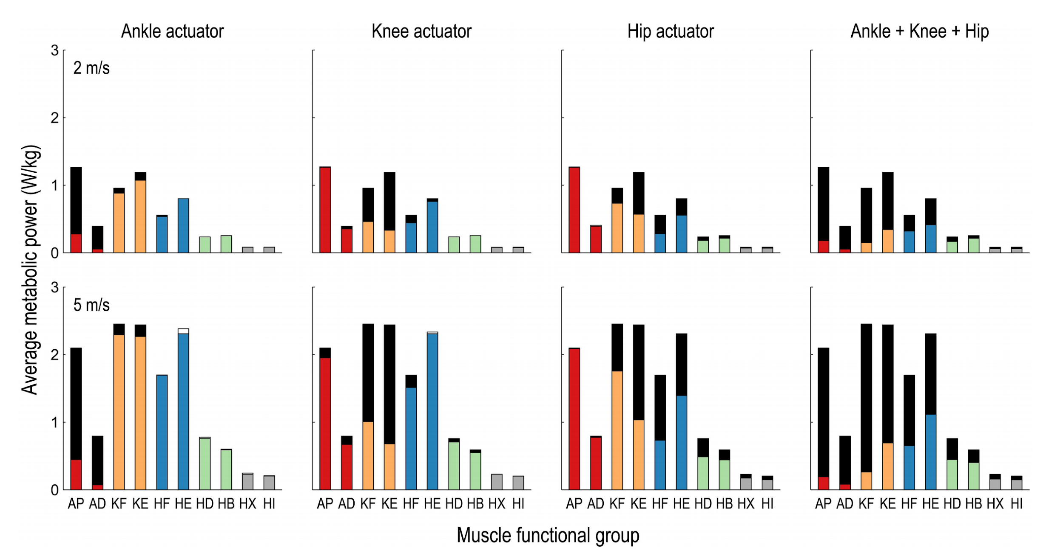
Review: History of OpenSim and MEER
OpenSim was released as an open-source tool by Dr. Scott Delp and team at Stanford in 2007
OpenSim has been used to study MEER of walking and running, making use of the Computed Muscle Control (CMC) Tool (Uchida 2016, Hamner 2013)
MEER results are often validated with indirect calorimetry experimental measurements (Uchida 2016, Hamner 2013)
MEER output normalized by body weight for running for each leg muscle (Uchida 2016)
Notes:
SR
Another quick review is on OpenSim, a biomechanical computational tool that was developed by Scott Delp and his group at Stanford.
OpenSim has been used to study metabolics of other types of movement by making use of the Computed Muscle Control CMC tool which calculates synergistic muscle activations to produce kinematics with minimum deviations from a desired motion.
Metabolics can be validated with experimental measurements of gas exchange via indirect calorimetry.
Used extensively in biomechanics research & industry
The CMC tool calculates synergistic muscle activations to produce a motion that best matches the imposed kinematics, outputting MEER

Slide 11
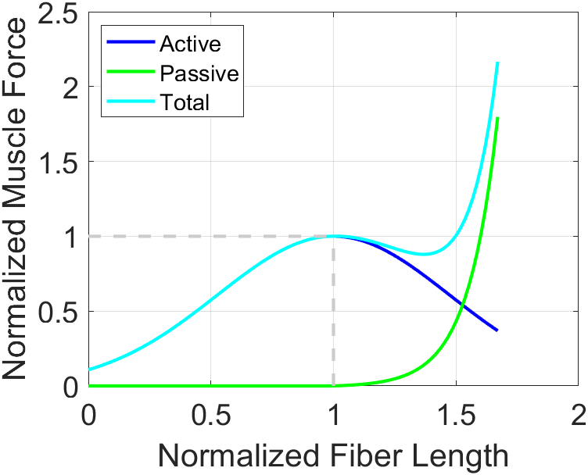
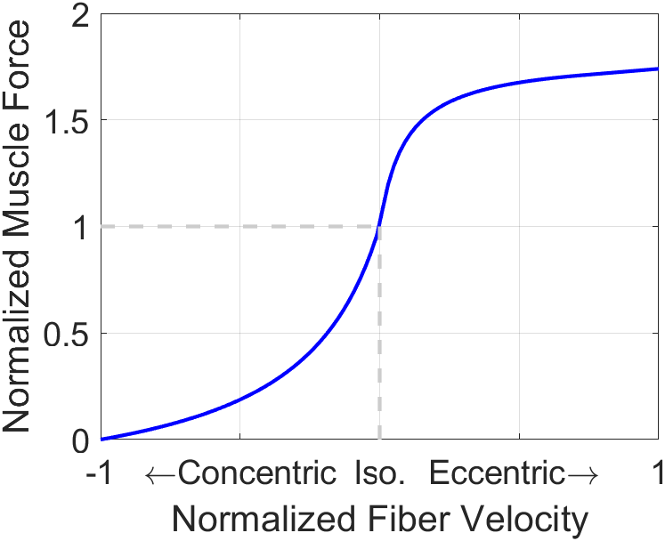
Review: Biomechanical Analysis
Muscle states
Muscle fiber length
Muscle fiber velocity (speed of contraction)
Active force generating capacity is the product of the active force due to muscle length and the force due to muscle velocity
If a muscle has a higher active force generating capacity, less activation will be required to generate a given motion and the MEER will be smaller (Bohm 2019, Alcazar 2019)
Active force-length and force-velocity curves for active force generation (OpenSim Documentation)
Notes:
SR
Thus, we can use the muscle states data as a secondary measure to analyze changes in MEER as the model changes
New background information that has and will become increasingly important as we move forward is centered on biomechanical analysis.
From OpenSim, we can extract muscle states, such as force-length and force-velocity relationships of muscle as seen in the figure on the right, which are used in calculating muscle forces and thus metabolic energy expenditure rates
There have been studies performed that have validated through modeling and experimental measurements that these muscle states have important implications for muscle efficiency
Thus, analysis of these muscles states can be used to analyze how metabolics change as a function of seat position
And now David will bring us through the refined workflow used for our complete analysis of one case

Slide 12
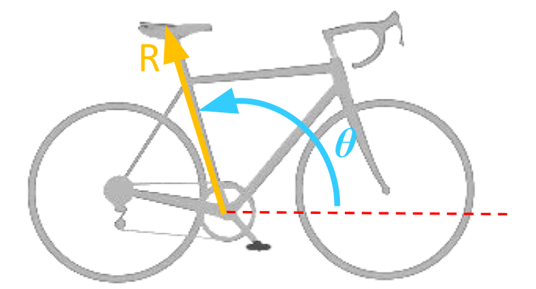
Problem Definition
Our goal is to establish a computational workflow for Specialized to relate MEER and bicycle saddle position (R, 𝜽) to inform bicycle design
Notes:
SR

Slide 13
Problem Definition
Our goal is to establish a computational workflow for Specialized to relate MEER and bicycle saddle position (R, 𝜽) to inform bicycle design
We validated this workflow by relating changes in bicycle saddle position to MEER through simulation in OpenSim
Notes:
SR
80rpm

Slide 14
Methods
Notes:
DG - 7

Slide 15
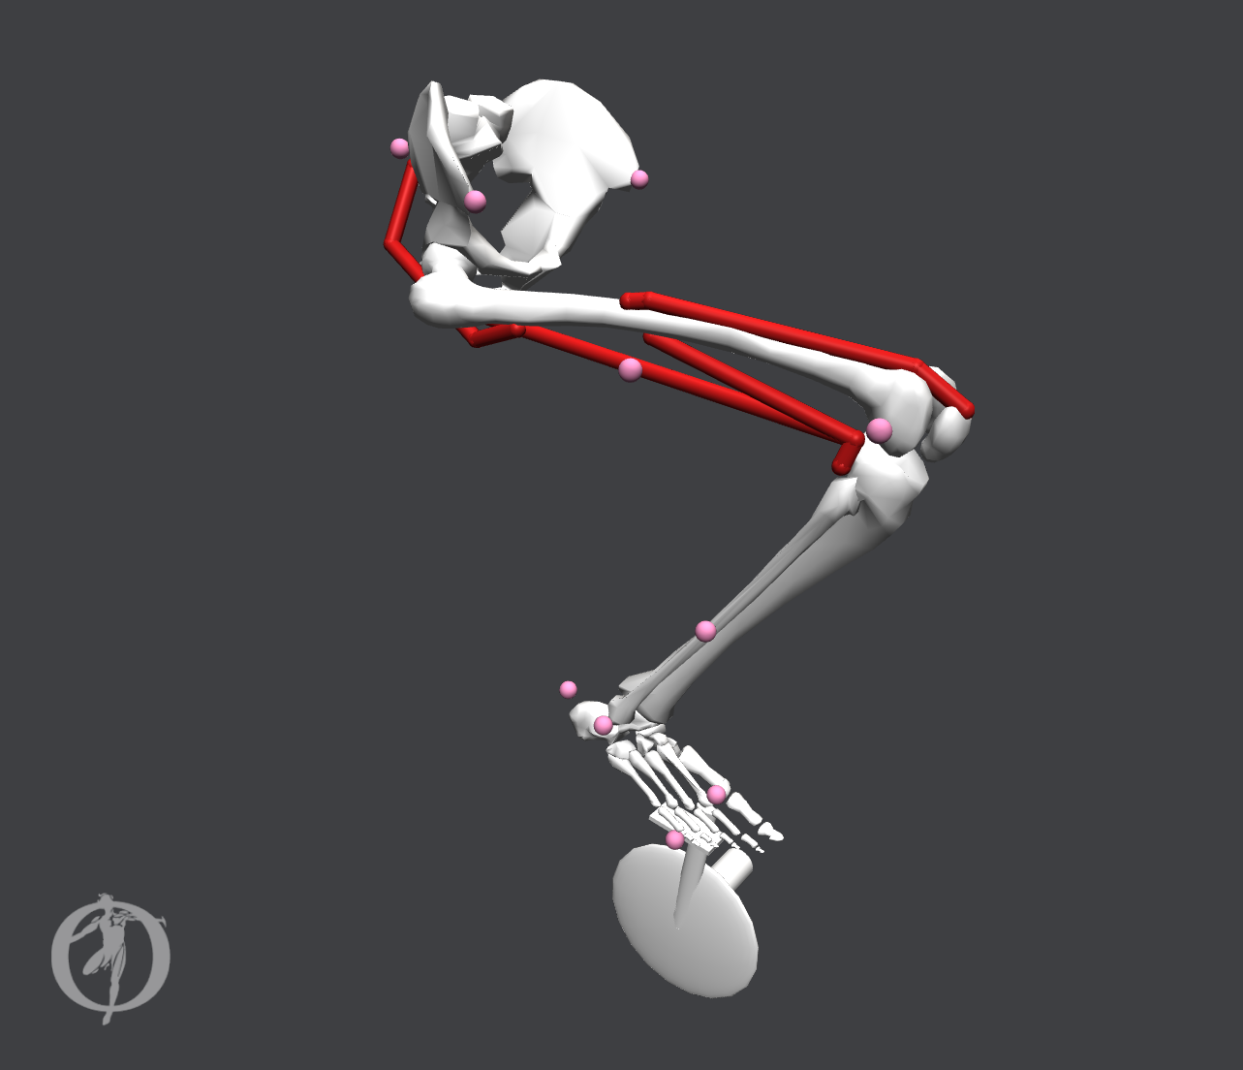
Methods: Model
Single leg model
Notes:
DG
1 right leg plus a bicycle bottom bracket with 1 right pedal
This will be sufficient to demonstrate our workflow for cycling analysis

Slide 16
Methods: Model
Vastus Intermedius
Single leg model
4 muscles: 1 quadricep, 2 hamstrings, 1 glute
Gluteus Maximus
Biceps Femoris
Long Head
Biceps Femoris
Short Head
Notes:
DG
Our simplified leg only includes for upper leg muscles.
1 quadricep, the vastus intermedius extends the knee
2 hamstrings, the biceps femoris long and short head for hip and knee extend the hip and flex the knee,
1 glute, the gluteus maximus which also serves to extend the hip.

Slide 17
Methods: Model
Pelvis:
Translation (3X) Rotation (3X)
Single leg model
4 muscles: 1 quadricep, 2 hamstrings, 1 glute
13 Degrees of Freedom (DOF)
Hip:
Rotation (3X)
Knee Angle
Ankle Angle
Toe Angle
Crank Angle
Notes:
DG
The leg features 13 controllable degrees of freedom
(list off DOF from figure)
MTP = meta tarso pha langeal joints (MTP joints)

Slide 18
Methods: Model
Pelvis:
All 6 DOF locked
Single leg model
4 muscles: 1 quadricep, 2 hamstrings, 1 glute
13 Degrees of Freedom (DOF)
Constraints: pelvis, pedal clip
Pedal Clip:
All translations & rotations coupled
Notes:
DG
Key component of our model are the constraints
Fully constrain the pelvis in space
No longer able to translate in space -> Important to keep the pelvis at the correct saddle position
No longer able to rotate in any manner -> important since there is no musculature included for stabilizing moments and torques at the pelvis
We couple all motion of the foot and bottom bracket crank pedal with a “pedal clip” constraint
Keeping the foot on the pedal at all times during our simulations is necessary to represent cycling

Slide 19
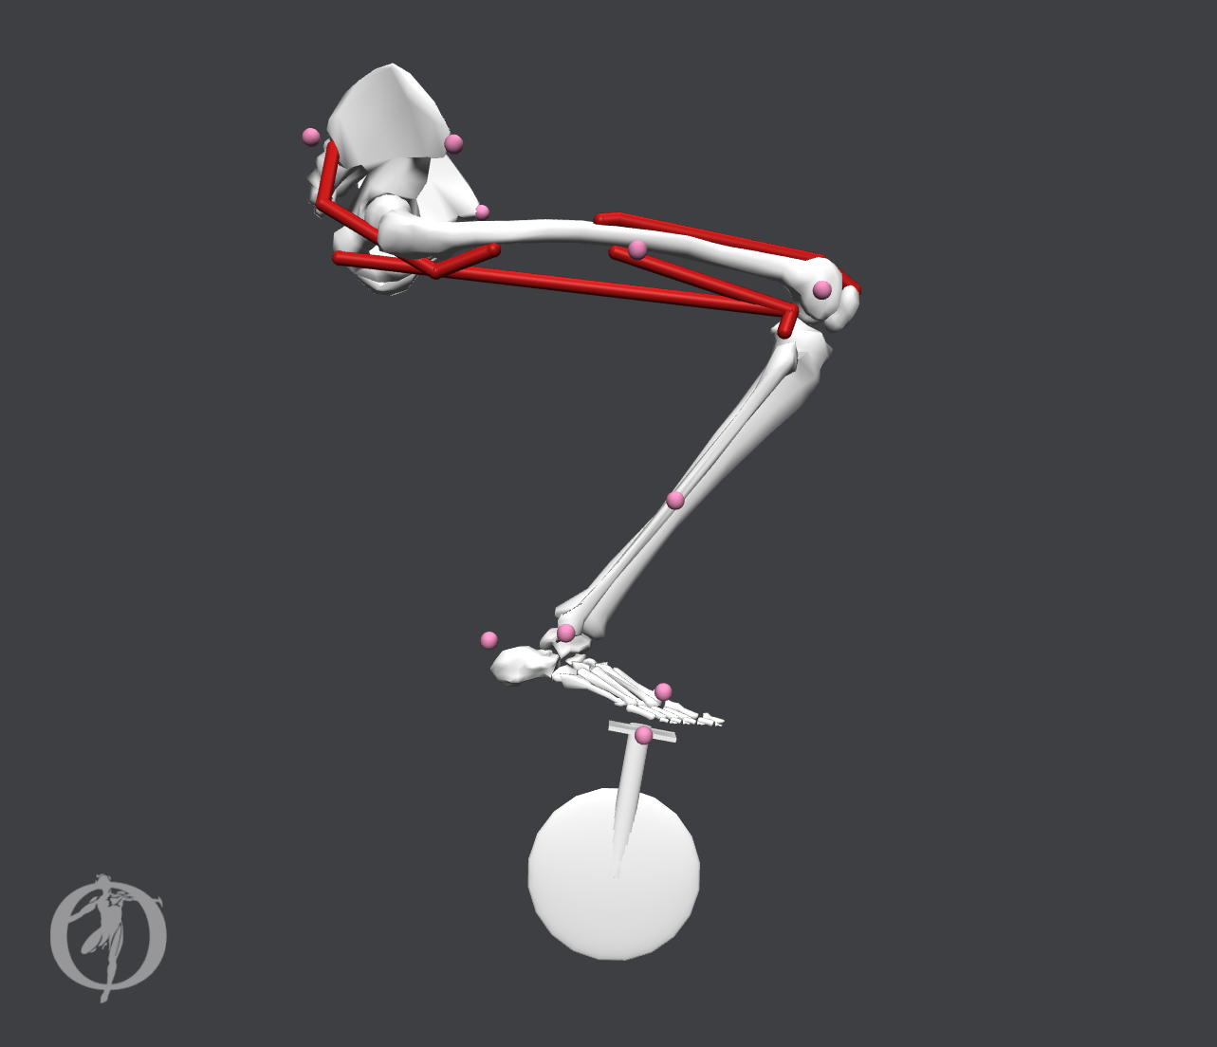
Methods: OpenSim Tools
Forward Dynamics Tool
Given initial position and constraints, determines the motion of the model
Notes:
DG
OpenSim’s forward dynamics tool is exactly as it sounds. Either external forces from the environment around your model and/or muscle forces from user-defined activations will drive the motion of the model forward in time during the simulation

Slide 20
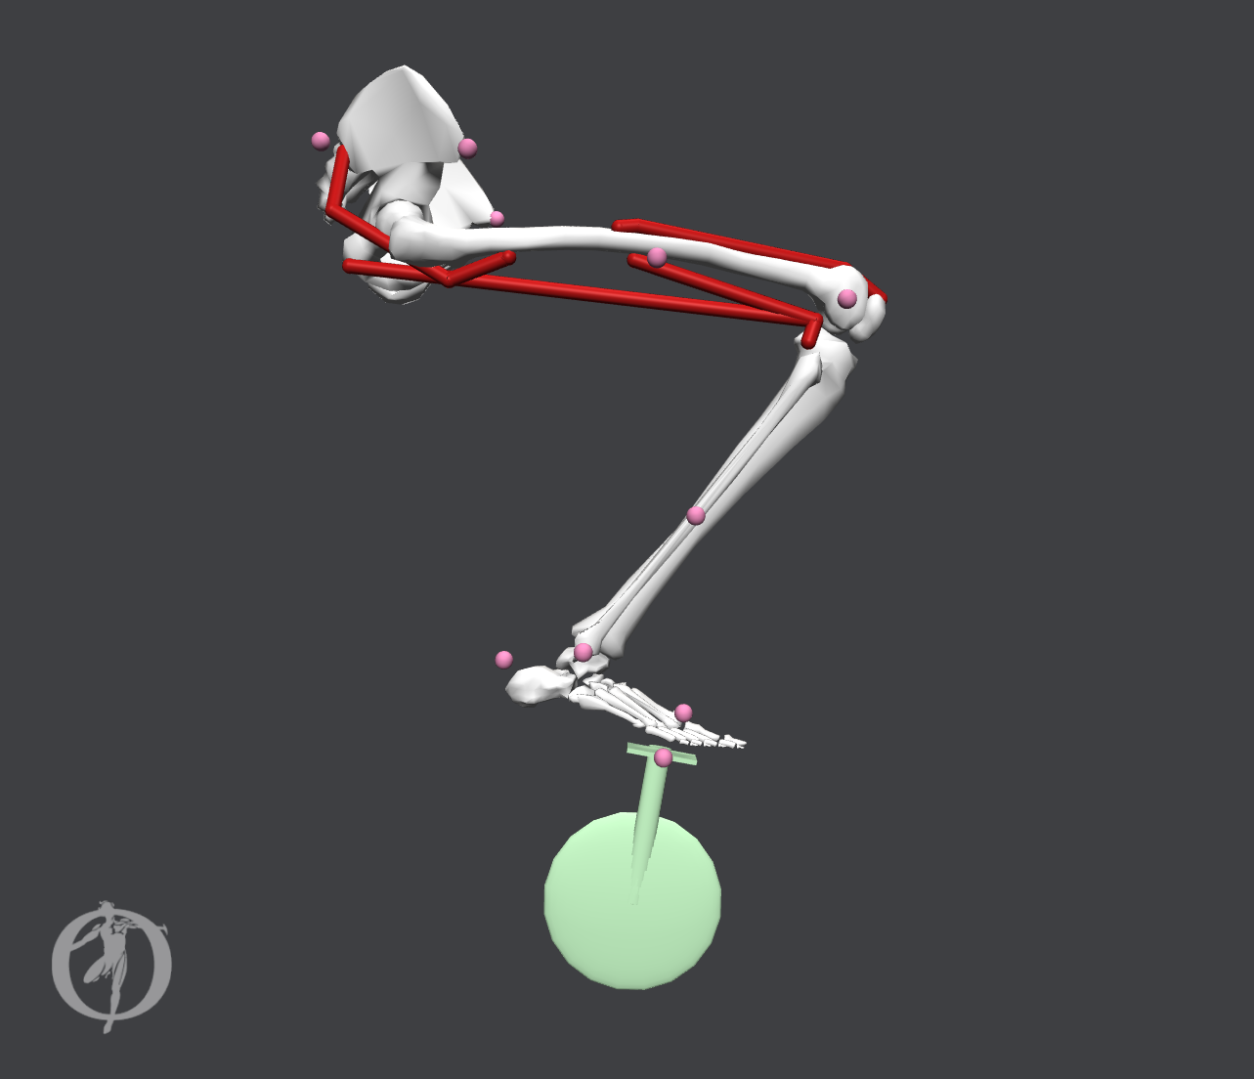
Methods: OpenSim Tools
Forward Dynamics Tool
Given initial position and constraints, determines the motion of the model
Model DOF(s) can be driven via prescribed function
Notes:
DG
However,instead of just relying on explicitly stating external forces, the user can prescribe a function with respect to time to any of the degrees of freedom.
This is essentially a velocity constraint for this degree of freedom.
Now we can generate a set of model kinematics without having to know about all of the forces acting on the leg during cycling, but instead allow the velocity of the crank to determine the motion of the model.
Can prescribe a function to any of the DOF, and the model will move to satisfy the motion.

Slide 21
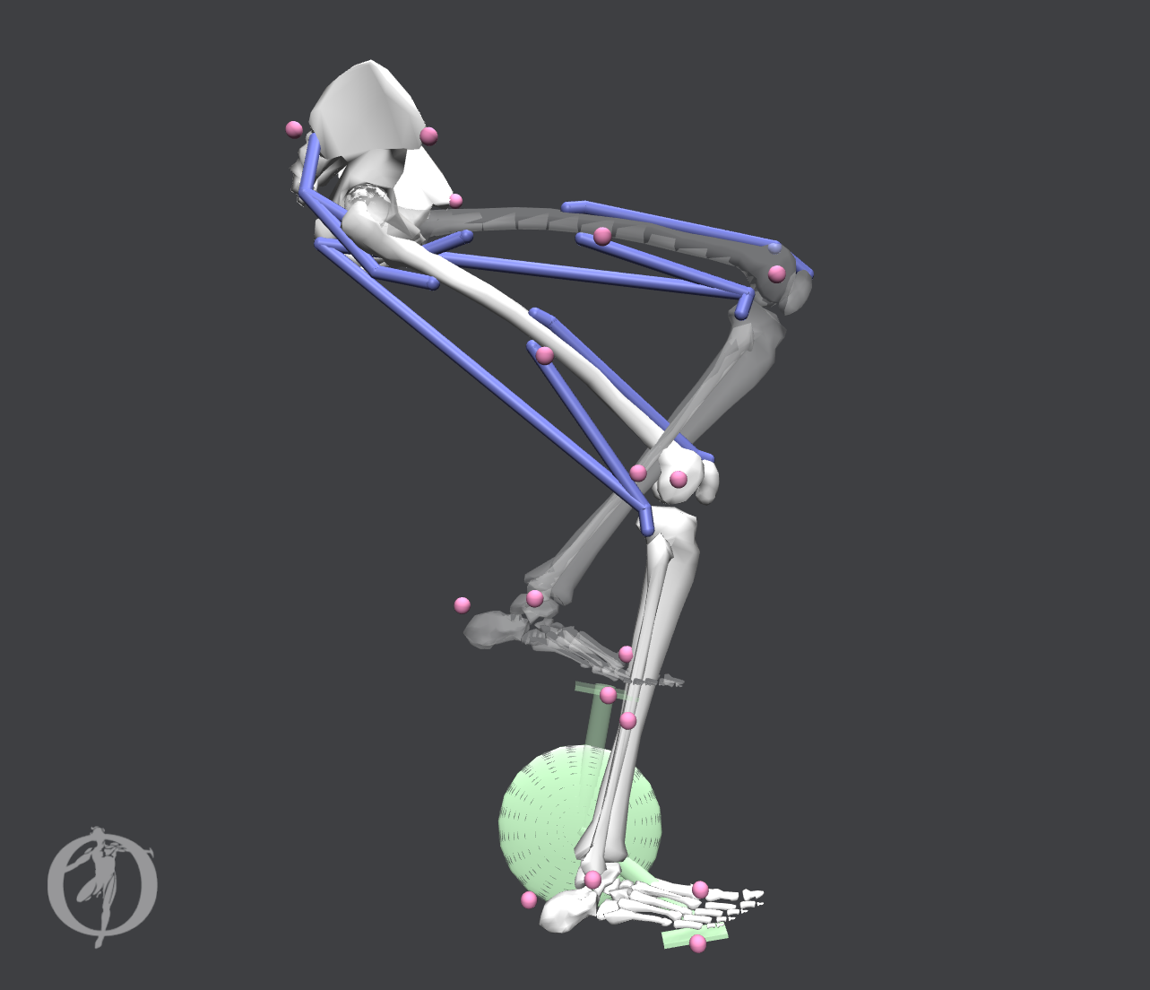
Methods: OpenSim Tools
Forward Dynamics Tool
Given initial position and constraints, determines the motion of the model
Model DOF(s) can be driven via prescribed function
In the Workflow: Simulated Forward Kinematics (SFK) step
Outputs model joint angles, muscle fiber lengths, muscle fiber velocities, and pedal reaction forces at the midfoot
ω_{crank} = 80 RPM
Notes:
DG
Within the context of our Workflow, we leverage the Forward Dynamics Tool for our “Simulated Forward Kinematics” step, or SFK for short.
For SFK, we prescribe a function of 80 rotations per minute to the crank angle, and in conjunction with the pedal clip constraint, we can produce model motion without needed to explicitly state external forces acting on the model.

Slide 22
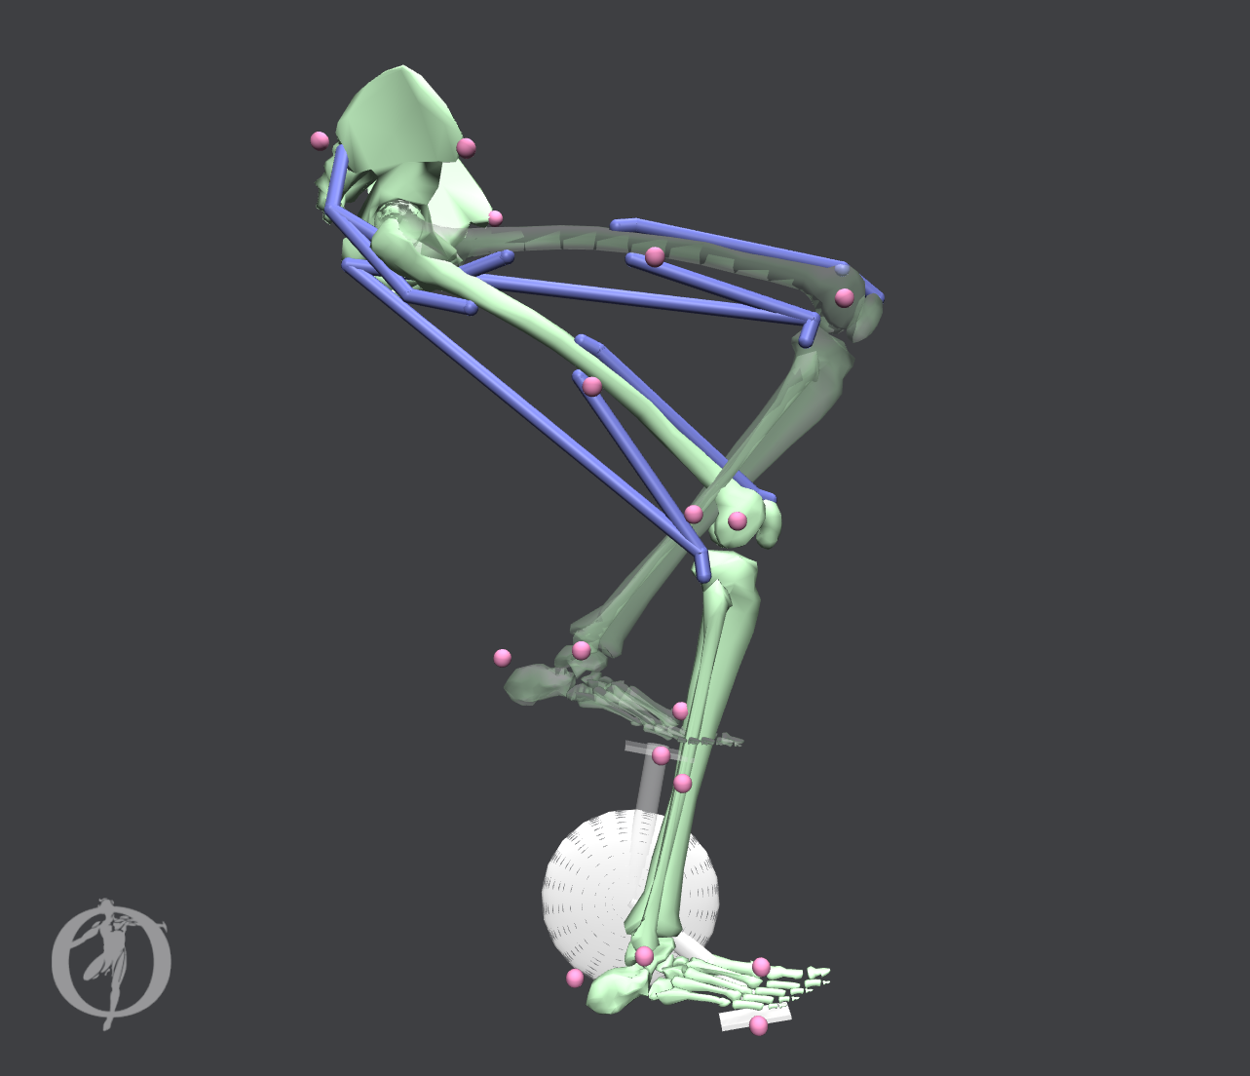
Methods: OpenSim Tools
Computed Muscle Control Tool
Notes:
DG
Now to talk about the second primary tool relevant to our study: Computed Muscle Control Tool, or CMC for short

Slide 23

Methods: OpenSim Tools
Computed Muscle Control Tool
Given a desired motion and external forces, determines muscle activations needed to reproduce the motion
a_{vas_int}= ?
a_{bifemlh}= ?
a_{muscle} ∈ [0, 1]
Notes:
DG
Now with CMC, instead of imposing external forces or velocity constraints on the model, we instead ask the model to track some desired motion. And for that desired motion, the model determines the appropriate muscle activations which would recreate the desired motion for the model. The muscle activations themselves are simply fractional values ranging from 0 to 1 that measure how much of the muscle is being recruited / being utilized to produce a force.
Unlike the Forward Dynamics Tool where we prescribe a function and have a sort of velocity constraint on our system, there several combinations of muscle activations that the model could find that generate some type of cycling motion. Naturally, as for any problem space with a large range of potential solutions, the CMC Tool performs some optimization to address this.

Slide 24
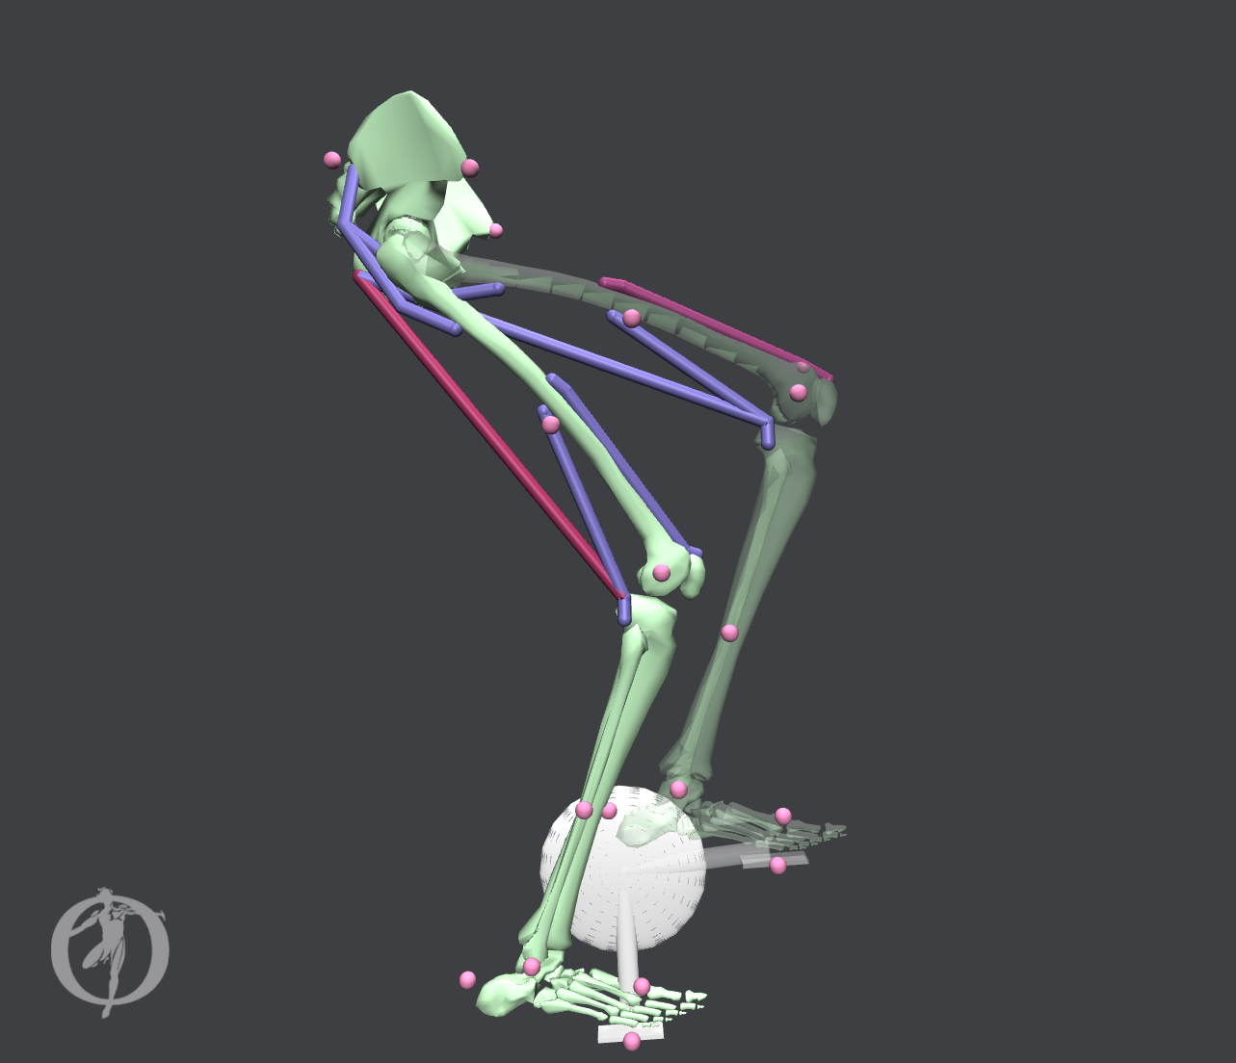
Methods: OpenSim Tools
Computed Muscle Control Tool
Given a desired motion and external forces, determines muscle activations needed to reproduce the motion
Optimization minimizes activations and deviations from desired motion J = Σw_{i} x_{i}² + Σw_{j} ( q’’_{j, des} - q’’_{j, CMC} )²
a_{vas_int}
a_{bifemlh}
a_{muscle} ∈ [0, 1]
Notes:
DG
Since muscles in the human body are redundant, meaning it is more often than not that more than 1 muscle is applying forces in the same direction or generating moment about the same joint, optimization needs to be done to find a specific solution.
CMC Tool chooses an objective function J to minimize for its optimization solver.
The x-i’s are the activations for all muscles in the body, as well as for any other external forces being applied to the model to help produce a desired motion.
The pair of q double prime desired and q double prime CMC correspond to the desired joint accelerations with are the input into the CMC Tool, and the actual joint accelerations being produced by the CMC Tool during simulation.
The weights on activations for muscles and weights on deviations in joint angle accelerations are set by the user.
Also, not all joint angles/ degrees of freedom need to be tracked. Typically, a smaller subset is selected, referred to as the tracking tasks, to help specify the optimization problem for the CMC Tool.
Muscle activation measures the recruitment of muscles being used to generate a force a_{muscle} ∈ [0, 1]

Slide 25
Methods: OpenSim Tools
Computed Muscle Control Tool
Given a desired motion and external forces, determines muscle activations needed to reproduce the motion
Optimization minimizes activations and deviations from desired motion J = Σw_{i} x_{i}² + Σw_{j} ( q’’_{j, des} - q’’_{j, CMC} )²
In the Workflow: CMC Tool step
Activations used to calculate MEER directly
a_{vas_int}
a_{bifemlh}
a_{muscle} ∈ [0, 1]
Notes:
DG
In the context of our workflow, the CMC Tool really defines our CMC Step. We will tell our model to track some desired cycling motion, and then have returned as an output, a set of muscle activations for our four muscles that should reproduce the desired cycling motion without too much deviation.
There are two things to watch for when logically checking the results of the CMC Tool based on the optimization
Does the motion look correct / similar to what was given as an input?
Do the timing of muscle activations occur where one would expect from experience / EMG studies?
And now Cait will talk through the workflow using the tools we’ve talked about here.

Slide 26
Workflow
Notes:
CEC - 4
Now I am going to walk you through the computational workflow that we developed and used to analyze a set of saddle positions with our model and tools that David just explained.

Slide 27
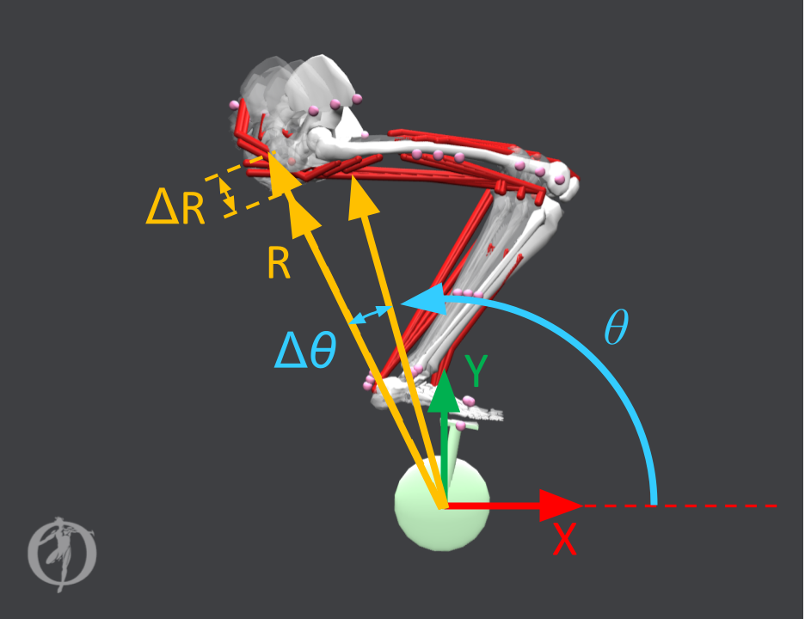
Workflow: Inputs
6 unique saddle positions
(R,θ) = (0.8196 m, 102°)
(R,θ) = (0.8196 m, 105°)
(R,θ) = (0.8196 m, 108°)
(R,θ) = (0.8396 m, 102°)
(R,θ) = (0.8396 m, 105°)
(R,θ) = (0.8396 m, 108°)
Saddle positions (R, θ) correspond to locations of the pelvis with respect to the bottom bracket
The parametrized saddle position is defined by:
R = seat tube height & θ = seat tube angle
Notes:
CEC
The parameterized input to our model was the saddle position of the bicycle with respect to the bottom bracket.
This was implemented by moving the pelvis local coordinate frame with respect to the bottom bracket as shown in the figure.
The figure on the right shows how the angle and heights are varied for the different trials.
The pelvis location is calculated from a seat tube height, R, and a seat tube angle, θ.
We chose three seat tube angles: θ = {102°, 105°, 108°}, and two seat tube heights: R = {0.8196 m, 0.8396 m}, giving us six unique saddle positions for our investigation.

Slide 28
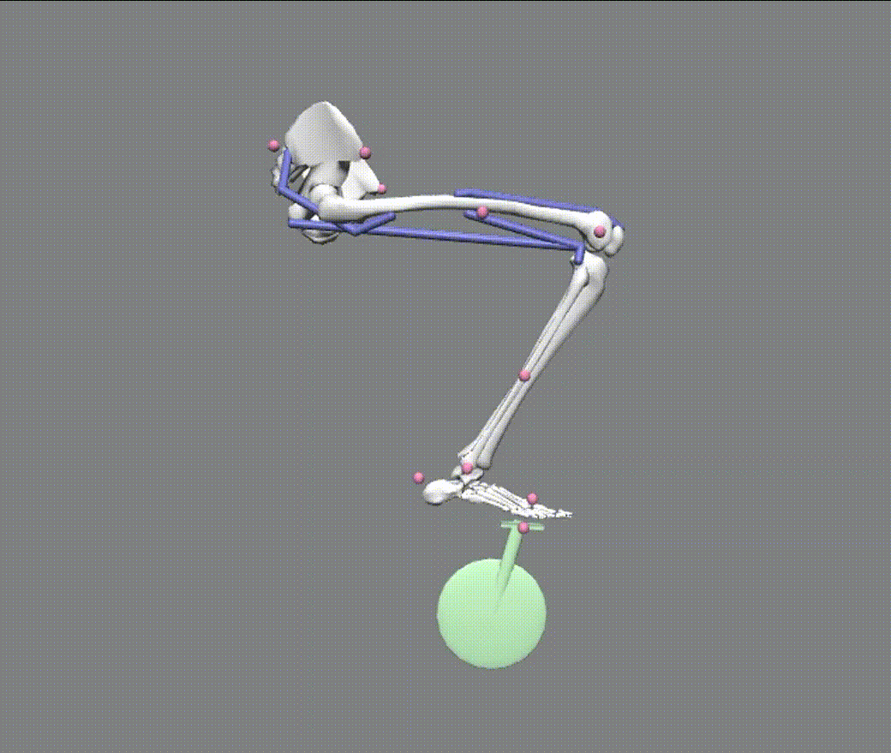
Workflow: Simulated Forward Kinematics (SFK)
Constant pedaling speed (80 RPM) was prescribed to the crank angle
Model passively followed crank via pedal clip constraint
Joint angles, muscle lengths, muscle velocities, and reaction forces at the pedal clip constraint vs. time were extracted
Pedal reaction forces were smoothed in MATLAB for each subsequent CMC trial
Notes:
CEC
The Simulated Forward Kinematics (SFK) step of the workflow was where the model leg passively followed a cycling motion, and the motion and reaction force data for the leg was stored for later analysis.
This step substituted data normally collected from motion capture experiments where joint angles of a subject would be recorded as the subject performs some motion, and external reaction forces would be measured from force plates.
This was achieved by prescribing a constant velocity function of 80 RPM to the crank angle of the model, and then the model passively followed the crank via the pedal clip constraint.
The key outputs of SFK step trials were joint angles, muscle fiber lengths, muscle fiber velocities, and reaction pedal forces at the midfoot vs. time.
Pedal reaction forces were smoothed in MATLAB for each subsequent CMC trial.
Joint angles and the smoothed reaction forces from SFK were used as inputs for the next step of our workflow.

Slide 29
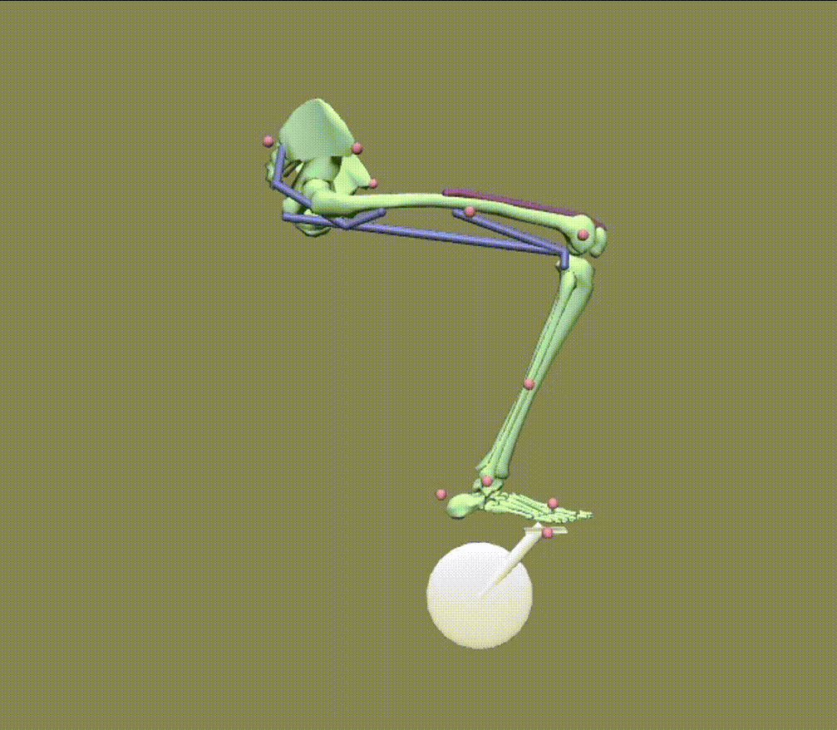
Workflow: Computed Muscle Control (CMC)
The CMC Tool generated the muscle activations required for the model’s muscles to produce the same motion from the SFK step
Minimized: J = Σw_{i} x_{i}² + Σw_{j} ( q’’_{j, des} - q’’_{j, CMC} )²
CMC Tool may find unstable solutions and fail to solve a trial
From muscle activations, MEER, was calculated
Notes:
CEC
This brings us to the Computed Muscle Control, or CMC tool, step
The CMC Tool was used to calculate the muscle activations required for the model’s muscles to produce the same motion from the SFK step.
In order to do this, the kinematics of the DOF of the model were “tracked” with the CMC Tool optimization objective function such that the CMC model’s kinematics most closely matched the SFK model’s kinematics
At every time step in the CMC simulation, a set of muscle activations were solved via the minimized optimization function to propagate the model forward in time.
While tracking a desired subset of joint angles, the CMC Tool generated a solution of muscle activations to produce the motion of the SFK Trial.
The DOF that were tracked during the CMC simulation were the crank angle, hip angle, knee angle, and metatarsophalangeal (mtp/toe) angle.
The crank angle was included in the tracking tasks for all of our trials, primarily to help ensure a constant pedaling motion at 80 rpm.
The CMC simulation can be unstable in the sense that a solution of muscle activations may not always be found for the entire simulation window.
From muscle activations found with the CMC Tool, MEER was calculated
Settings of the CMC Tool must be adjusted among the six different trials until convergence and a solution are determined for the entire simulation time of 0.75 seconds.
We dealt with this obstacle by slightly adjusting the weighting of the reserve actuators of only the crank angle among the six CMC trials until a solution for the entire simulation time was found.
Tuning the actuators refers to increasing or decreasing the cost of using an actuator with respect to the objective function (Equation (3)).
We limited tuning of reserve actuators to only a reserve actuator located at the bottom bracket. This helps turn the crank when the model leg cannot exert sufficient torque to drive the motion and turn the crank at a rate of 80 rpm.

Slide 30
Workflow: Organization of Analysis
Metabolic Energy Expenditure Rate (MEER) Analysis
Analysis & comparison of full-cycle averaged MEER for all 6 trials
Analysis of MEER of trial with minimum full-cycle averaged MEER: (R,θ) = (0.8196 m, 108°)
Active Force Capacity Analysis
Gain insights & validate MEER results without explicitly calculating MEER
Analysis of muscle states of trial with minimum full-cycle averaged MEER: (R,θ) = (0.8196 m, 108°)
Notes:
CEC
We then analyzed and plotted the data for the muscles’ MEER in MATLAB versus crank angle to compare the outcomes of the different saddle positions.
This is a COMPARATIVE TOOL in that the absolute values that we will see on the next slides shouldn’t be taken as much as the comparison between trials.
We will present the full-cycle averaged MEER over the entire revolution to capture the results of the entire cycling revolution.
This averaged value is more stable and gets rid of numerical instability from sharp peaks in the data.
We will also look at the MEER for the entire cycle for one of the saddle position cases.
We also validated our MEER analysis with muscle states analysis.
Recall, muscle states are the muscle fiber lengths and muscle fiber velocities for a particular muscle at a moment in time.
The active force generating capacity of a muscle is based on the muscle state as it is the product of the force due to the muscle length and the force due to the muscle velocity
If a muscle has a higher active force generating capacity due to its muscle states, the muscle will require less activation to generate the same amount of force
So, with a larger active force generating capacity, less activation will be required to generate a given motion and the MEER will be smaller than when compared to a muscle with a lower active force generating capacity.
Thus,we can determine insights about MEER without calculating MEER.
We showed that this muscle states active force capacity analysis was used to validate the MEER results.
As mentioned previously, the muscle states outputs of the Simulated Forward Kinematics step are used to calculate the active force capacity of muscle.

Slide 31
Results & Analysis
Notes:
CC - 7 min
I’ll be covering the results and analysis of our saddle positions input and show how these results validate our computational workflow

Slide 32
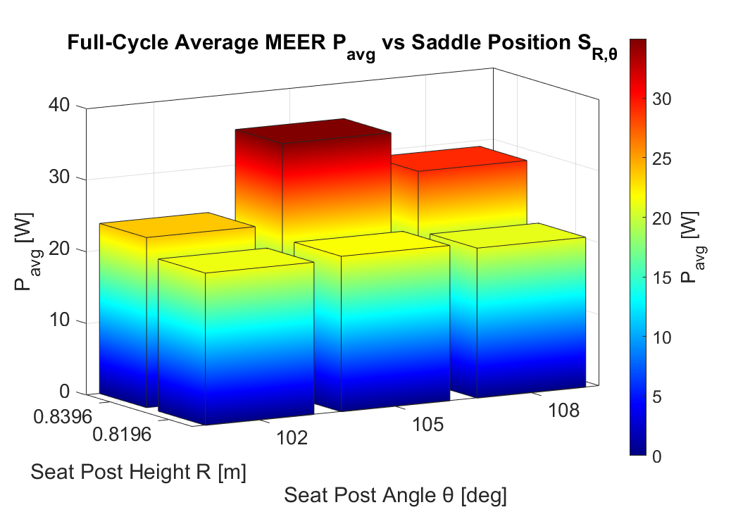
Results: Full-Cycle Average MEER vs. Saddle Position
Smallest full-cycle average MEER (R, θ) = (0.8196 m, 108°)
Notes:
CC
3D bar plot showing the full cycle average MEER for all 6 saddle positions.
You can see that there are trends in the data where the MEER at the lower radius of 0.8196 is smaller than the MEERs at the larger radius of 0.8396.
Takeaway is that the smallest full cycle average MEER is at the saddle position r = 0.8196 and theta = 108 degrees. This means, this position is considered the most efficient of the 6 saddle positions we trialed.

Slide 33
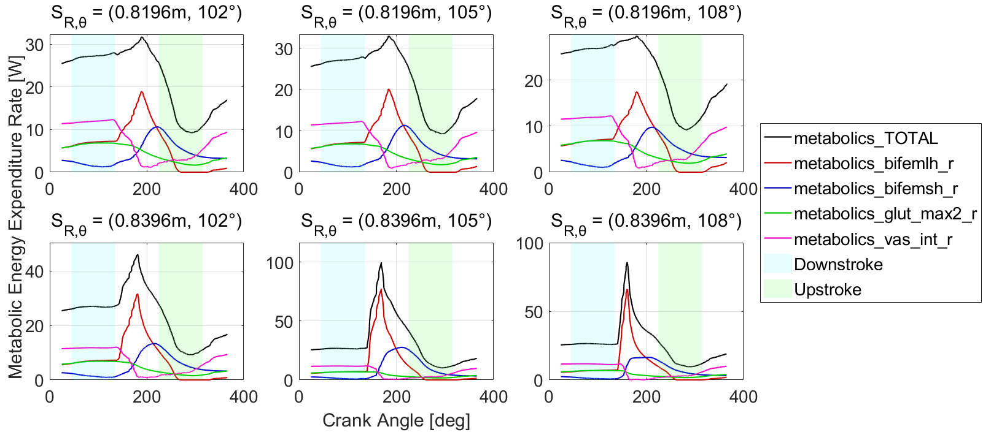
Results: MEER vs. Crank Angle (all Saddle Positions)
Notes:
CC
We have the individual MEERs over the full crank angle for each saddle position. The graphs show 5 lines with 4 of them representing the individual muscle MEERs and 1 line representing the total MEER for that saddle position.
There’s a lot of information here to digest, so lets zoom in on just 1 of our plots to examine, our smallest MEER position where r = 0.8196 and theta = 108 deg.

Slide 34
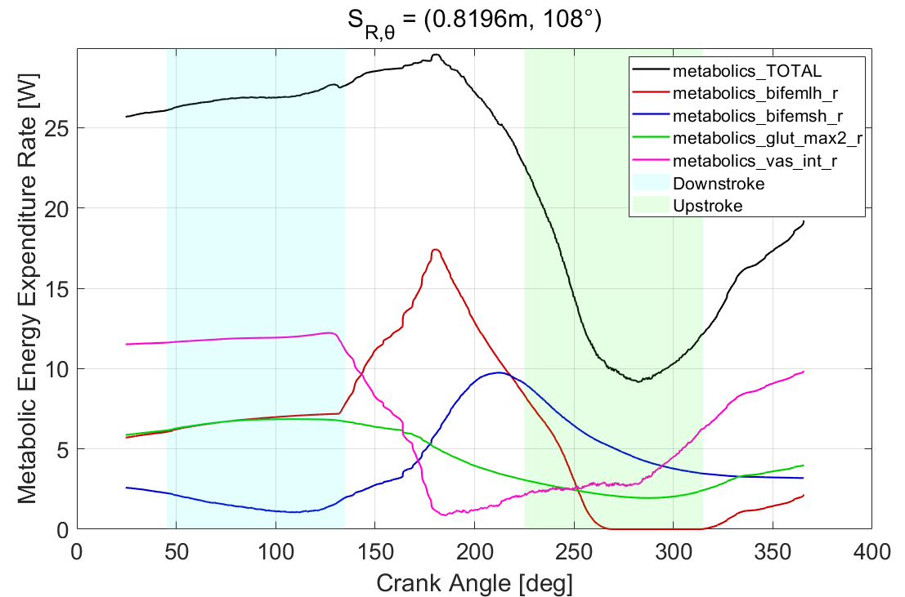
Results: MEER vs. Crank Angle, (R, θ) = (0.8196 m, 108°)
Biceps femoris long head peaks at transition to upstroke
Vastus intermedius peaks in downstroke
Notes:
CC
We can see the 5 lines more clearly: black line is the total MEER, and the colored lines represent 1 of the 4 muscles on our model.
This plot is extremely useful in helping us validate our model. The trends that we see here are hugely significant as they show us that our SFK step in our workflow, where we simulated motion, is capable of reproducing realistic dynamics and realistic relative MEERs.
So what we’re doing here is that we’re checking when each muscle is activated in the crank cycle and validating this with empirical evidence.
For example, we see the biceps femoris long head peaking in the transition region between the downstroke and the upstroke. This is dynamically realistic of a pedaling motion because this is the point in the cycle where your hamstring activates to pull your leg backward.
As another key takeaway, we can look at the trend for vastus intermedius. We see that it reaches its highest value during the downstroke, which makes sense as this is where your quad activates to exert force on the pedal. We see the trend dip down in the transition region before rising again through the tail end of the upstroke region. This is empirically validated as @300deg of the crank angle, vas_int begins contracting to sweep the lower leg forward which explains the upward trend in MEER for this muscle

Slide 35
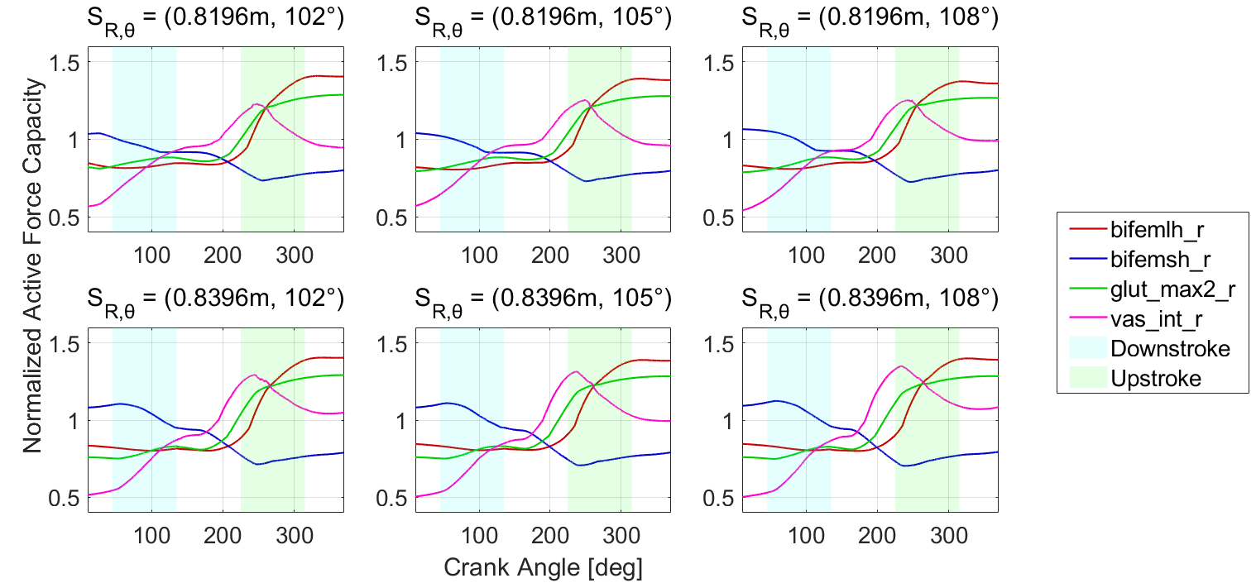
Results: Active Force Capacity (all Saddle Positions)
Notes:
CC
In addition to MEER outputs, as Cait mentioned in our analysis methods, we also looked at the active force generating capacity which is calculated from the muscle states which are obtained from our sfk step.
These are important to study as muscle states (active force capacity during concentric contraction) can be used to validate MEER as described by Sepehr in our introduction and background.
Here, we can see that we generated active force capacity plots for each of our 6 saddle positions over the entire length of the crank angle.
Again, there’s a lot of information here, so we’ll zoom into just 1 plot, the same saddle position that we examined a few slide back where r = 0.8196 and theta is 108deg.

Slide 36
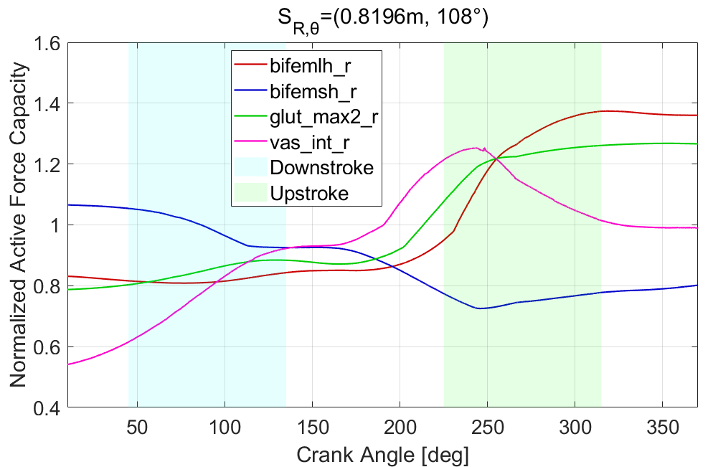
Results: Active Force Capacity, (R, θ) = (0.8196 m, 108°)
Biceps femoris long head force peaks at maximum eccentric contraction
Vastus intermedius force peaks at maximum fiber length
Biceps femoris short head force decreases due to decreasing muscle fiber length
Notes:
CC
Looking @ that trial, we are checking to see that the muscle states correspond to the realistic motion, essentially that the muscle fiber lengths and muscle velocities are accurately represented throughout the crank angle.
Some of the key takeaways are:
<read takeaway on slide> Eccentric contraction is when the muscle is elongating and doing negative work. This corresponds well to the motion as in the tail end of the upstroke, the knee extends which allows biceps femoris lh to move eccentrically. Also because it attached at the hip.
For the next one, we see that the vastus intermedius force peaks at maximum fiber length. This is also biomechanically accurate as the muscle reaches its longest during the very beginning of the upstroke.
Finally we see the bicep femoris short head force decreasing throughout the crnak angle and this is due to decreasing muscle fiber length which also validates our empirical understanding.
In Summary, the trends we observe in this plot validates the model and the workflow’s ability to produce active force capacity plots that are representative of a cycling motion.

Slide 37
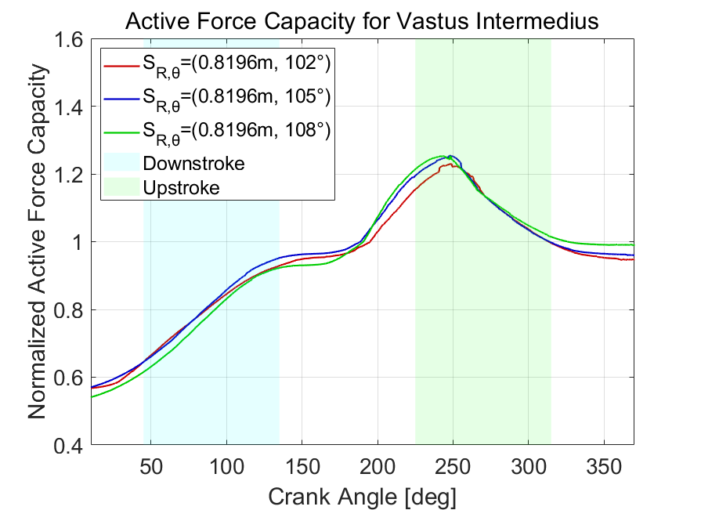
Results: Active Force Capacity for Vastii at R = 0.8196 m
Saddle position at θ = 102° has smallest active force capacity
Notes:
CC
To see how these active force capacity plots can be used as further validation for our MEER results, let’s see a graph of the active force capacity of the vastus intermedius muscle. We are looking at 3 saddle positions here all at r = 0.8196.
We can conclude here that the saddle position at theta = 102 has the smallest active force capacity, and that’s especially noticeable at the beginning of the upstroke.
This particular activation time point is relevant to consider as we saw in the previous graph, the knee extends during the upstroke, using the vas_int.
Most importantly, this gives us insights about MEER for the vastus at these saddle positions.

Slide 38
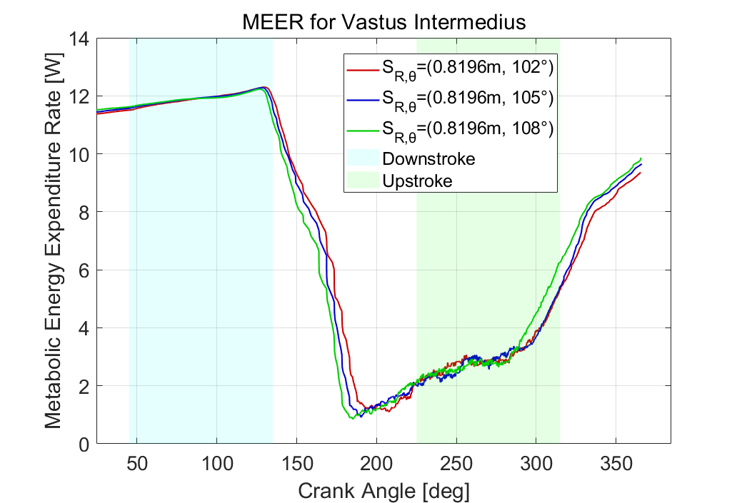
Results: MEER for Vastii at R = 0.8196 m
Full-cycle average MEER is highest at θ = 102°
Notes:
(R,θ)=(0.8196m, 102°): MEER_avg = 5.896 W
(R,θ)=(0.8196m, 105°): MEER_avg = 5.7998 W
(R,θ)=(0.8196m, 108°): MEER_avg = 5.8057 W
To see this, we can show the MEER for the same 3 saddle positions at r = 0.8196. After calculating average MEER, we noted that the full cycle average MEER is highest at theta = 102 which confirms the previous graph’s conclusions and shows how muscle states can be used to extract insights about MEER.
And now i’ll pass it to cait to share where this project goes from here

Slide 39


Moving Forward
Notes:
CEC - 2
As we compiled and analyzed the results from our workflow, we arrived at the level of complexity for our OpenSim model based on our goal to develop a computational workflow to understand the relationship between saddle position and MEER.

Slide 40
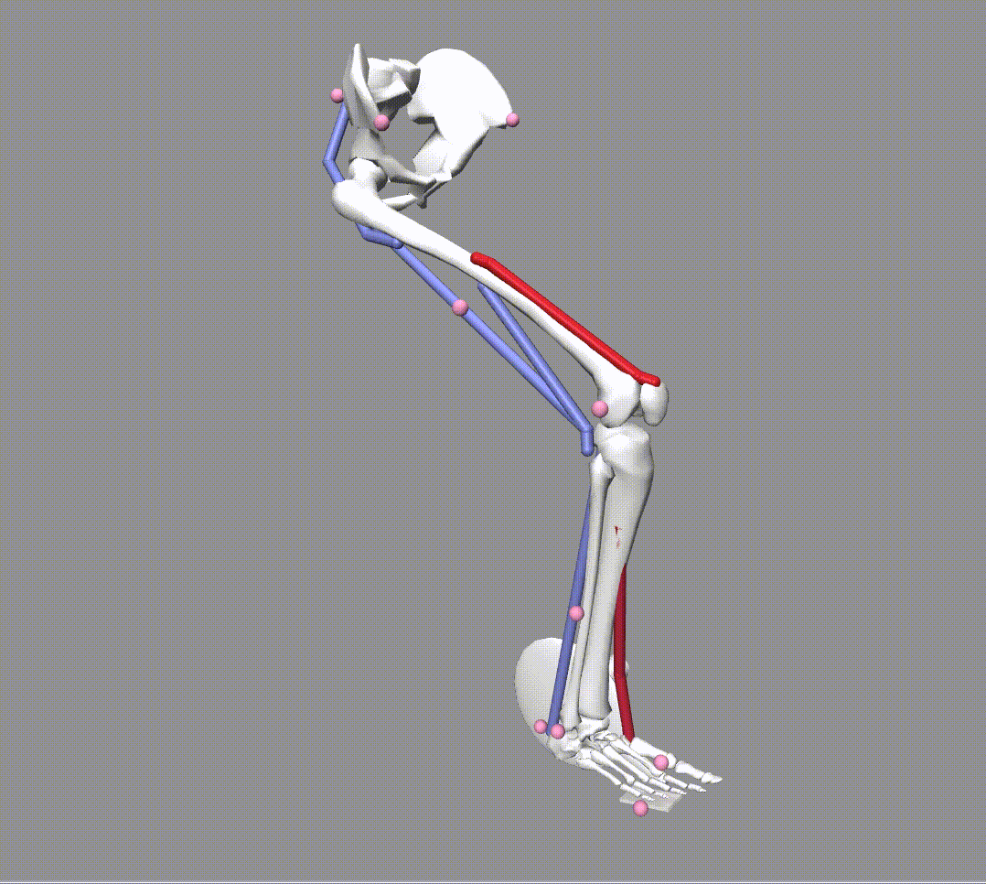
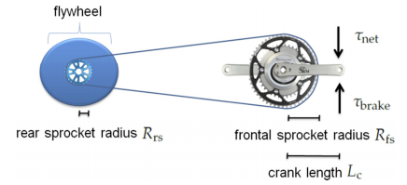
Moving Forward: Adding Model Complexity
Incorporating Resistance Torque
Adding Gastrocnemius & Tibialis Anterior
Schematic of brake/resistive torque in relation to crank and sprocket dimensions (Quintana-Duque 2015)
Notes:
CEC
We had also investigated and created proof-of-concept models to add to the model complexity including incorporating resistance torque at the crank and adding lower-leg muscles such as the gastroc and tibialis anterior. These may be incorporated by Specialized moving forward.
These were not included in the model used in our workflow today because adding complexity may not always add realism.

Slide 41

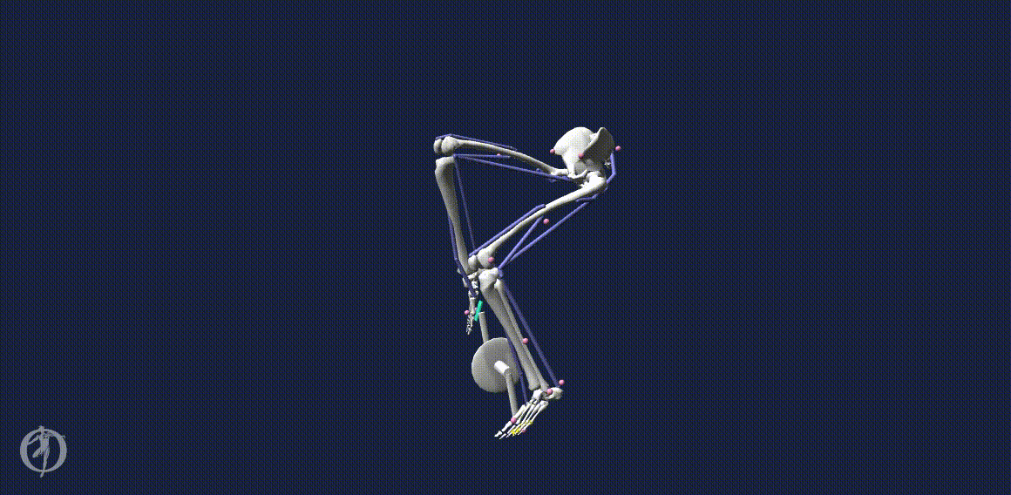
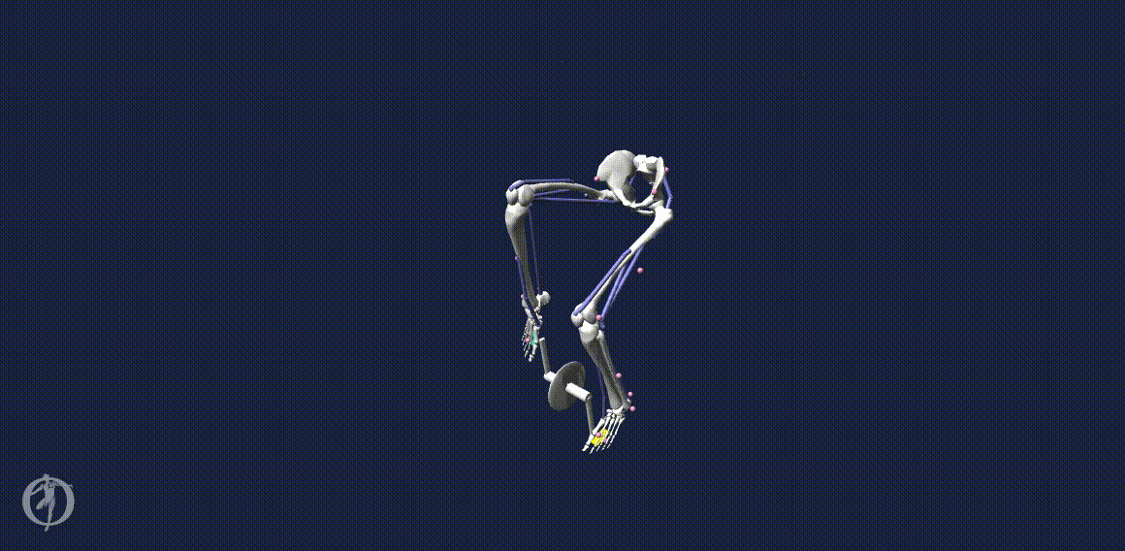
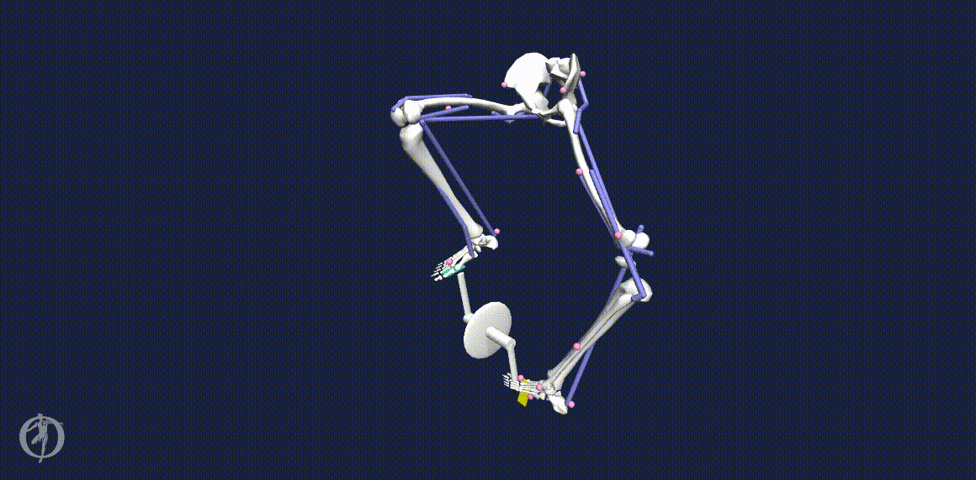
Moving Forward: Two-Legged Model
Notes:
CEC
Additionally, we had investigated a two-leg model, as seen in some of the trials on this slide as we worked toward debugging.

Slide 42
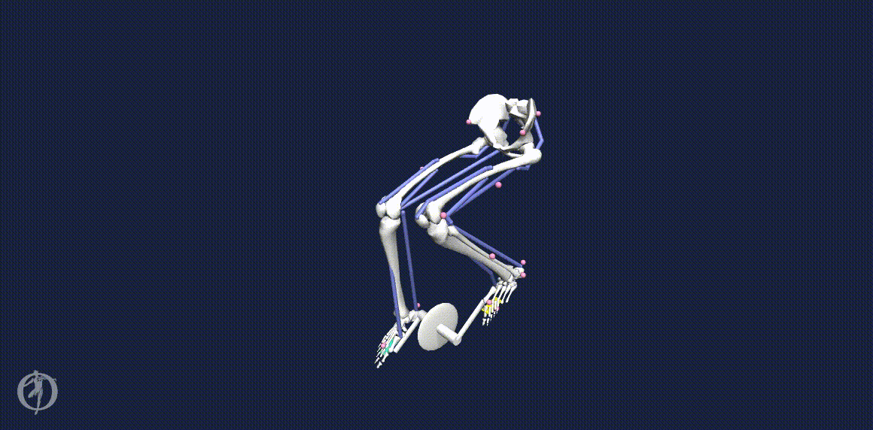
Moving Forward: Two-Legged Model
Completed SFK Run of Two-Legged Model for Specialized to Leverage in Future Analysis
Notes:
CEC
And, we were able to generate a completed SFK run of a two-legged model for Specialized to leverage in future analysis

Slide 43
Conclusions
Notes:
CEC

Slide 44
Conclusions
Developed a computational workflow to relate cyclist MEER to saddle position
Validated this workflow by obtaining and analyzing the results for a set of saddle positions
MEER analysis showed minimum MEER @ (R,θ) = (0.8396 m, 108°)
MEER analysis results were validated by biomechanics muscle states analysis
Specialized can now use this computational workflow method for quick results turnaround in their design cycle in place of traditional time-consuming experimental methods
Notes:
CEC
Overall, we developed a computational workflow to relate cyclist MEER to saddle position.
We validated this workflow and analyzed the results for a set of saddle positions, finding a minimum MEER at a specific saddle position and validated these results with the muscle states analysis.
This muscle states analysis can be used as a validation of MEER or can be used standalone for even quicker results turnaround and iterations.
This computational workflow method was created to be used in the place of time-consuming traditional sports performance analysis methods with experimental data collection.
This workflow method may now be used by our industry sponsor, Specialized, in their bicycle design cycle.

Slide 45
References
[1] Tucker, JT. (11 January 2021). Specialized ME319 Collaboration Kickoff Presentation.
[2] Faulkner, S. and Jobling, P. The Effect of Upper-Body Positioning on the Aerodynamic-Physiological Economy of Time-Trial Cycling. International Journal of Sports Physiology and Performance, (2020).
[3] Dodge, David. The Most Efficient Transportation On the Planet. Huffington Post Online (2013).
[4] Koelewign, A. D. et al. Metabolic cost calculations of gait using musculoskeletal energy models, a comparison study. PLOS ONE 14(9): e0222037, (2019).
[5] Dembia CL, Silder A, Uchida TK, Hicks JL, Delp SL Simulating ideal assistive devices to reduce the metabolic cost of walking with heavy loads. PLOS ONE 12(7): e0180320, (2017).
[6] Jackson, R. W. and Collins, S. H. An experimental comparison of the relative benefits of work and torque assistance in ankle exoskeletons. J Appl Physiol 119: 541–557, (2015).
[7] Leib, D. The Effects of Cleat Placement on Muscle Mechanics and Metabolic Efficiency in Prolonged Sub-Maximal Cycling. Ball State University Biomechanics Laboratory Thesis, (2008).
[8] Pottinger, M. Inverse Dynamic Analysis of ACL Reconstructed Knee Joint Biomechanics During Gait and Cycling Using OpenSim. California Polytechnic State University, San Luis Obispo Thesis, (2018).
[9] Coleman DA, Wiles JD, Davison RC, Smith MF, Swaine IL. Power output measurement during treadmill cycling. Int J Sports Med. ;28(6):525-30, (2007).
[10] Peveler, W. and Green, J. Effects Of Saddle Height On Economy And Anaerobic Power In Well-trained Cyclists. National Strength and Conditioning Association , Vol 25, 3, (2011).
[11] Hull, M.L. and Jorge, M. A Method For Biomechanical Analysis of Bicycle Pedalling. Journal of Biomechanics Vol 18 No 9. pp 631-644, (1985).
[12] Gonzalez, H. and Hull, M.L. Multivariable Optimization of Cycling Biomechanics. Journal of Biomechanics Vol. 22 No 11/12 pp 1151-1161, (1989).
[13] Uchida TK, Seth A, Pouya S, Dembia CL, Hicks JL, Delp SL (2016) Simulating Ideal Assistive Devices to Reduce the Metabolic Cost of Running. PLoS ONE 11
[14] Uchida TK, Hicks JL, Dembia CL, Delp SL (2016) Stretching Your Energetic Budget: How Tendon Compliance Affects the Metabolic Cost of Running. PLoS ONE 11
[15] Hamner, Samuel R, Delp, Scott L. Muscle contributions to fore-aft and vertical body mass center accelerations over a range of running speeds, Journal of Biomechanics, Volume 46, Issue 4, 2013
[16] Fonda, B., & Sarabon, N. (2010). Biomechanics of cycling ( Literature review ). Sport Science Review, 19(1), 187–210
[17] Ferrer-Roca V, Roig A, Galilea P, García-López J. Influence of saddle height on lower limb kinematics in well-trained cyclists: static vs. dynamic evaluation in bike fitting. J Strength Cond Res. 2012
[18] Bini RR, Tamborindeguy AC, Mota CB. Effects of saddle height, pedaling cadence, and workload on joint kinetics and kinematics during cycling. J Sport Rehabil. 2010
[19] Henrot, C and Jeffries, L. OpenSim Teaching Materials -- Educational Cycling Model. BIOE-ME 485 Spring 2018
[20]OpenSim::Umberger2010MuscleMetabolicsProbe Class Reference. OpenSim API 3.3 Documentation (2015).
[21] Uchida, Thomas K., et al. Biomechanics of Movement: The Science of Sports, Robotics, and Rehabilitation. The MIT Press, 2021.
Notes:
CEC

Slide 46
References
[22] Bohm Sebastian, Mersmann Falk, Santuz Alessandro, and Arampatzis Adamantios (2019) The force–length–velocity potential of the human soleus muscle is related to the energetic cost of running Proc. R. Soc. B.286
[23] Alcazar J, Csapo R, Ara I and Alegre LM (2019) On the Shape of the Force-Velocity Relationship in Skeletal Muscles: The Linear, the Hyperbolic, and the Double-Hyperbolic.
[24] Umberger, Brian R., Karin G.M. Gerritsen & Philip E. Martin (2003) A Model Of Human Muscle Energy Expenditure, Computer Methods In Biomechanics And Biomedical Engineering,
[25] Bini, Rodrigo & Hume, Patria & Croft, James. (2011). Effects of Bicycle Saddle Height on Knee Injury Risk and Cycling Performance. Sports medicine (Auckland, N.Z.). 41. 463-76. 10.2165/11588740-000000000-00000.
[26] Wozniak Timmer, Cheryl A., MS, PT. (1991). Cycling Biomechanics: A Literature Review. Journal of Orthopaedic & Sports Physical Therapy. 14:3. 106-113.
[27] Quintana-Duque, J.C., Dahmen, T., Saupe, D., 2015. Estimation of torque variation from pedal motion in cycling. Int. J. Comput. Sci. Sport 14, 34–50.
[28] Pappas, E (2019) Do Female Athletes get ACL injuries because of their ANATOMY?
[29] Gaesser GA, Brooks GA. Muscular efficiency during steady-rate exercise: effects of speed and work rate. J Appl Physiol. 1975 Jun;38(6):1132-9. doi: 10.1152/jappl.1975.38.6.1132. PMID: 1141128.
[30] CHOOSING BIKE TYPE. 2018. Recycled Cycles & Service. St. Louis, MO. http://www.recycledcycles.net/type1.html
[31] Kitawaki, Tomoki & Oka, H.. (2013). A measurement system for the bicycle crank angle using a wireless motion sensor attached to the crank arm. J Sci Cycling. Vol. 2(2), 13-19
[32] Wilkinson, R. (10 March 2021). Personal Correspondence via E-mail.
[33] Umberger BR, Gerritsen KG, Martin PE. Muscle fiber type effects on energetically optimal cadences in cycling. J Biomech. 2006;39(8):1472-9. doi: 10.1016/j.jbiomech.2005.03.025. Epub 2005 May 31. PMID: 15923008.
[34] SimTK::Assembler Class Reference. OpenSim Simbody 3.5 Documentation (2016). https://simbody.github.io/3.5.0/classSimTK_1_1Assembler.html
[35] OpenSim::AssemblySolver Class Reference. OpenSim API 4.1 Documentation (2020). https://simtk.org/api_docs/opensim/api_docs/classOpenSim_1_1AssemblySolver.html
[36] Tucker, JT. (12 March 2021). Week 9 Update Presentation
[37] Ong, C. (10 March 2021). Week 9 Correspondence.
[38] Uchida, T.K., Sherman, M., and Dembia, C. Simbody Assembler.cpp SimTK Open Source Simbody GitHub Repository. (24 July, 2017) https://github.com/simbody/simbody/blob/master/Simbody/src/Assembler.cpp#L754
[39] Carbonetto, P., Schmidt, M., and de Freitas, Nando. (2008) An interior-point stochastic approximation method and an L1-regularized delta rule. Advances in Neural Information Processing Systems (NIPS) Conference. Department of Computer Science, University of British Columbia Vancouver, B.C., Canada.
[40] Tsianos GA, MacFadden LN. Validated Predictions of Metabolic Energy Consumption for Submaximal Effort Movement. PLoS Comput Biol. 2016;12(6):e1004911. Published 2016 Jun 1. doi:10.1371/journal.pcbi.1004911
[41] “Getting Started with Forward Dynamics.” OpenSim Documentation. https://simtk-confluence.stanford.edu/display/OpenSim/Getting+Started+with+Forward+Dynamics
[42] “Getting Started with CMC.” OpenSim Documentation. https://simtk-confluence.stanford.edu/display/OpenSim/Getting+Started+with+CMC
Notes:
CEC

Slide 47
Thank you
Justin Tucker, Specialized mentor
Carmichael Ong, OpenSim expert/mentor
Ross Wilkinson, CU Boulder Researcher
Adrian Lew, Professor/mentor
Notes:
CEC

Slide 48
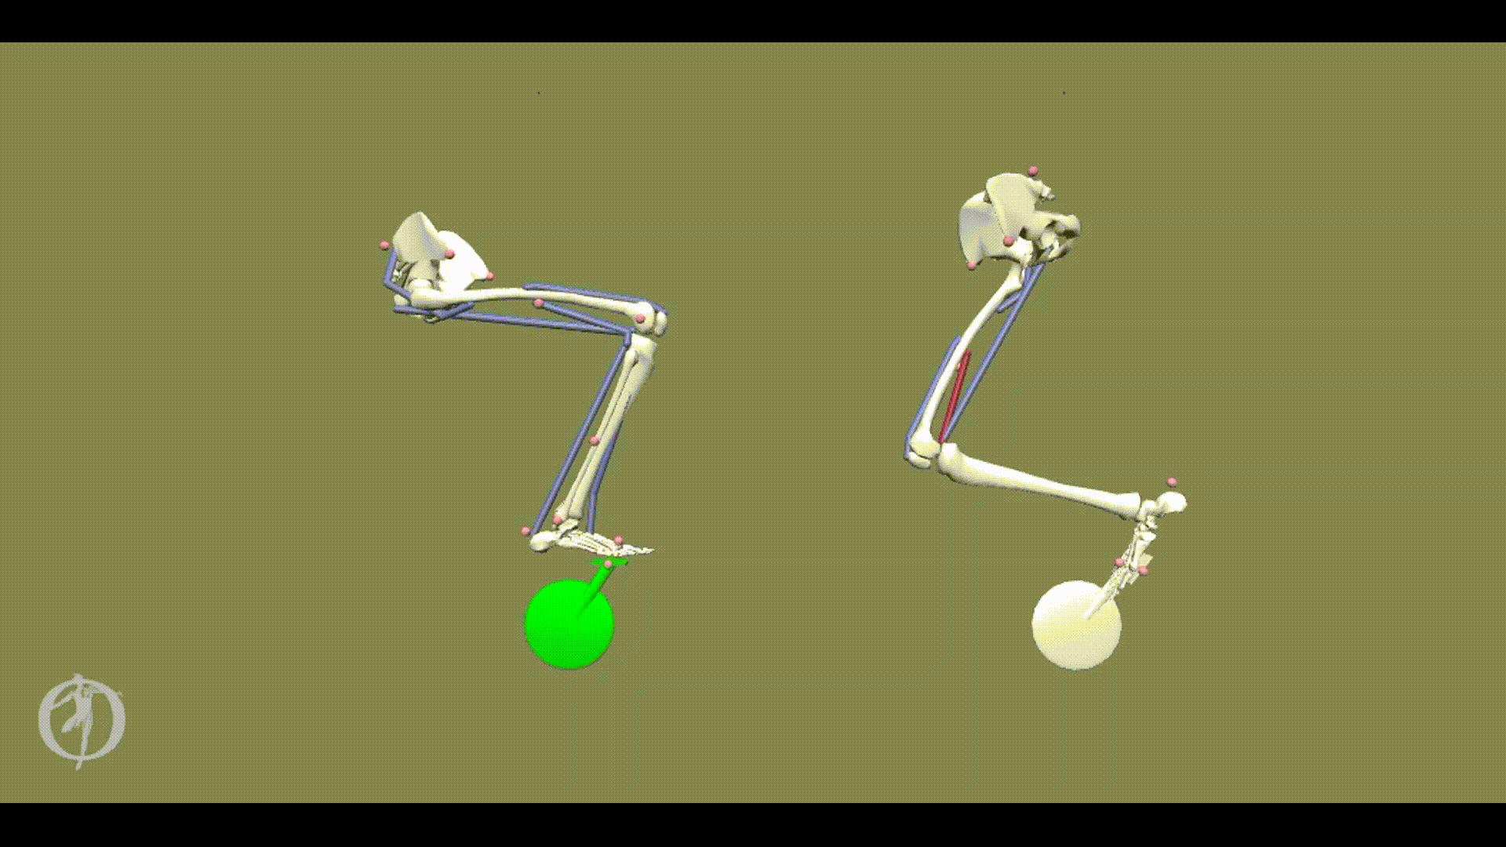



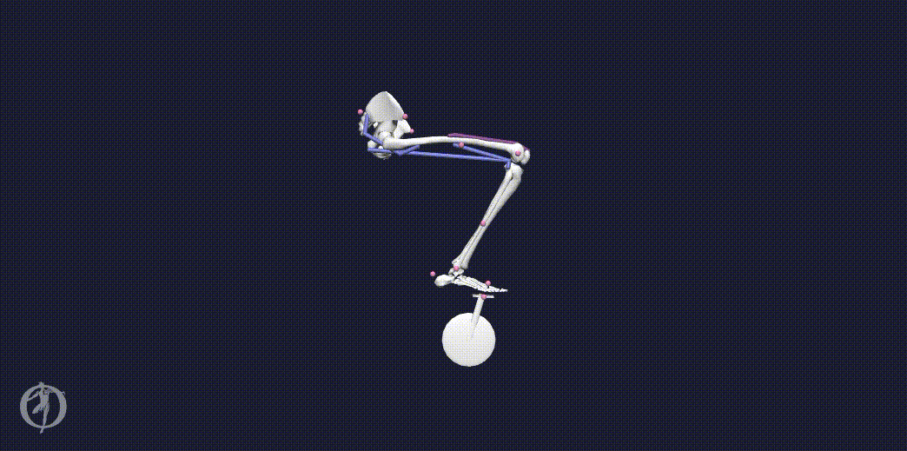
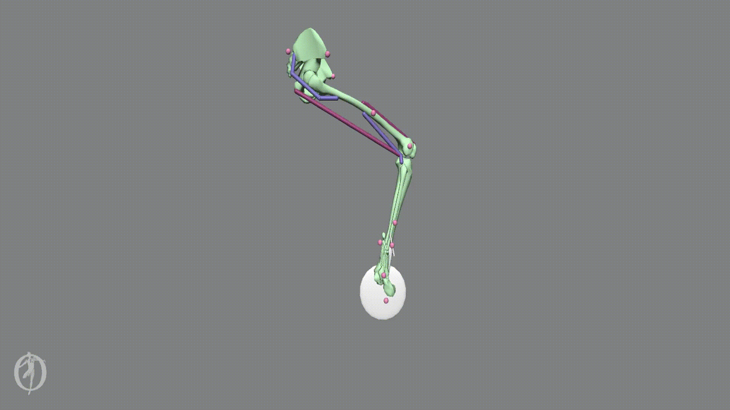

Thank you
INSERT BLOOPER GIFS
Notes:
CEC

